Slide 1
Chapter 2: BJT and its applications
Module 3 : BJT as an amplifier
Reference: Robert L. Boylestad, Louis Nashelsky, Electronic Devices & Circuits Theory, 11th Edition, PHI, 2012

Slide 2
Objectives
Discuss the basic concepts of an amplifier.
Analyze the RC coupled amplifier circuit with and without feedback.
Plot the frequency response of an amplifier and define the bandwidth.

Slide 3
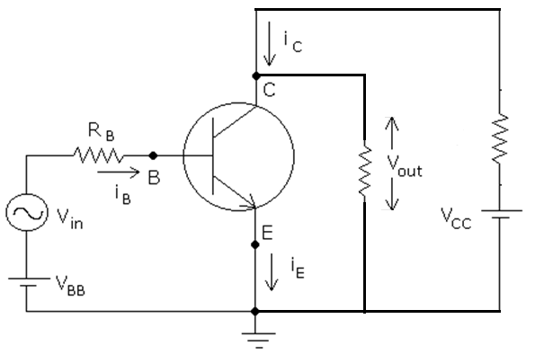
Transistor Amplifier
Base current is the input
Collector current is the output
BJT amplifies the input current as long as it is biased in active region

Slide 4

Current & Voltage Conventions
$V_{BB}$ , $V_{CC}$
$V_{BE}$, $V_{CB}$, $V_{CE}$
$I_{B}$, $I_{C}$ , $I_{E}$
$v_{be}$, $v_{ce} , v_{cb}$
$i_{b}$ , $i_{c}$ , $i_{e}$
$i_{C}$ = $i_{c}$+$I_{C}$
$i_{B}$ = $i_{b}$+$I_{B}$
DC
AC
DC+AC

Slide 5
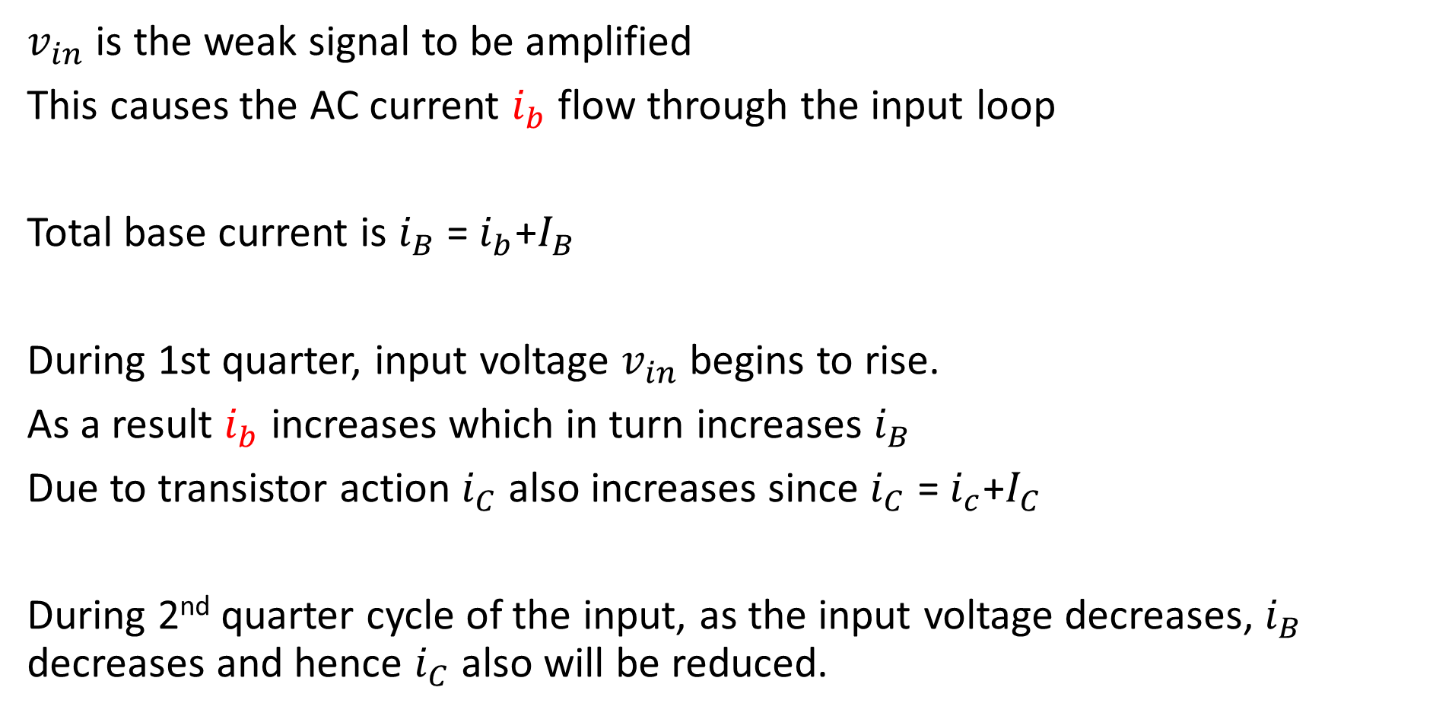
Working
$v_{in}$ is the weak signal to be amplified
This causes the AC current $i_{b}$ flow through the input loop
Total base current is $i_{B}$ = $i_{b}$+$I_{B}$
During 1st quarter, input voltage $v_{in}$ begins to rise.
As a result $i_{b}$ increases which in turn increases $i_{B}$
Due to transistor action $i_{C}$ also increases since $i_{C}$ = $i_{c}$+$I_{C}$
During 2nd quarter cycle of the input, as the input voltage decreases, $i_{B}$ decreases and hence $i_{C}$ also will be reduced.

Slide 6

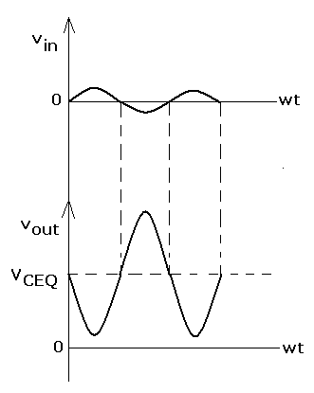
Output voltage will be amplified version of $v_{in}$ but 180 degree out of phase w.r.t input
$V_{out}$ = $v_{CE}$ = $V_{CC}$- $i_{C}R_{C}$
=$V_{CC}$-$\left(i_{c}\text{+}I_{C}\right)R_{C}$
When $v_{in}$=0, $V_{out}$=$V_{CEQ}$

Slide 7
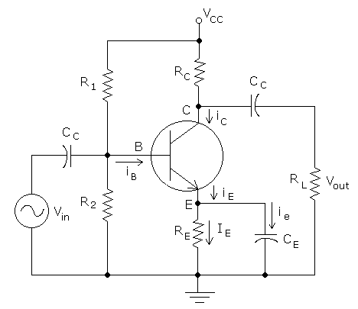
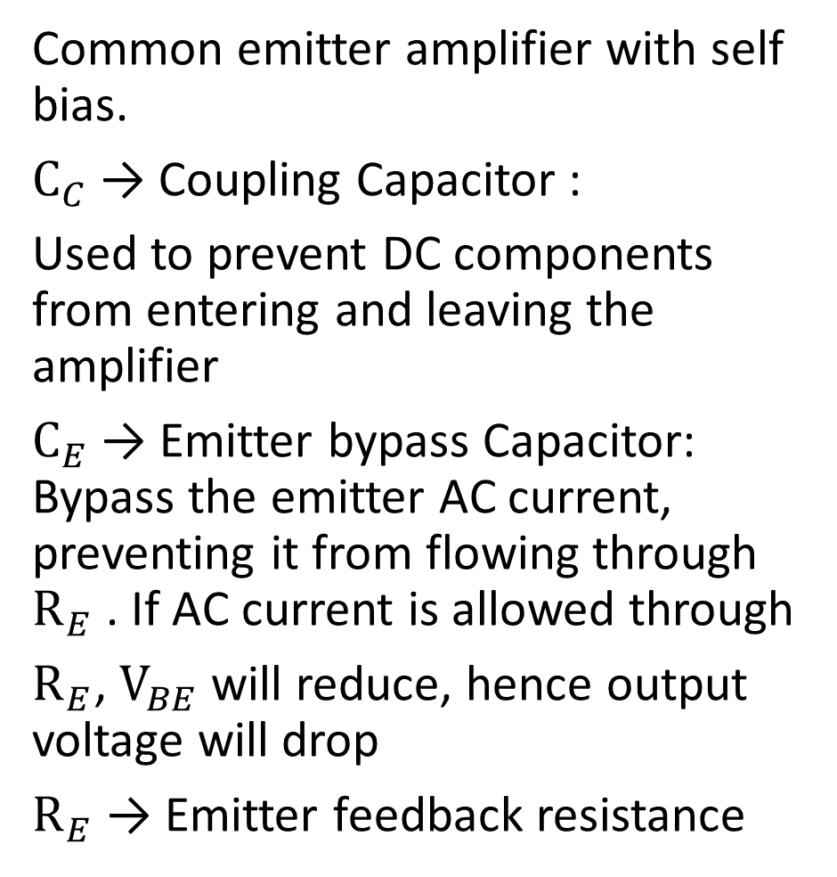
Common Emitter RC Coupled Amplifier
Common emitter amplifier with self bias.
$C_{C}$ → Coupling Capacitor :
Used to prevent DC components from entering and leaving the amplifier
$C_{E}$ → Emitter bypass Capacitor: Bypass the emitter AC current, preventing it from flowing through $R_{E}$ . If AC current is allowed through
$R_{E}$, $V_{BE}$ will reduce, hence output voltage will drop
$R_{E}$ → Emitter feedback resistance

Slide 9
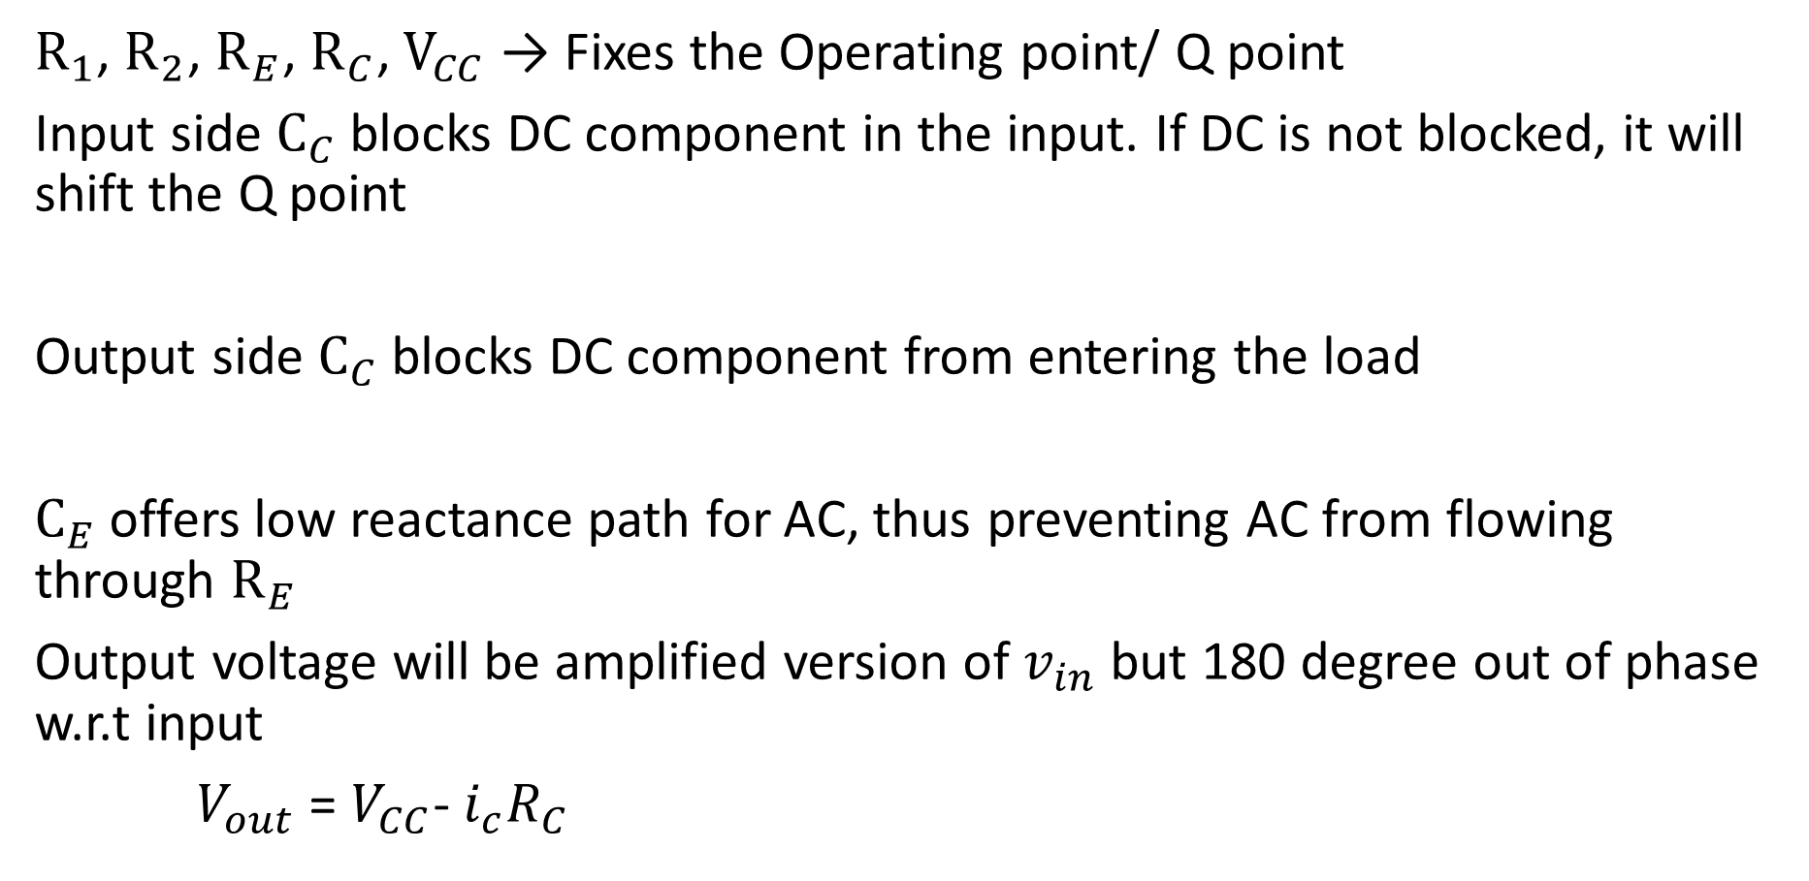
$R_{1}$, $R_{2}$, $R_{E}$, $R_{C}$, $V_{CC}$ → Fixes the Operating point/ Q point
Input side $C_{C}$ blocks DC component in the input. If DC is not blocked, it will shift the Q point
Output side $C_{C}$ blocks DC component from entering the load
$C_{E}$ offers low reactance path for AC, thus preventing AC from flowing through $R_{E}$
Output voltage will be amplified version of $v_{in}$ but 180 degree out of phase w.r.t input
$V_{out}$ = $V_{CC}$- $i_{c}R_{C}$

Slide 10
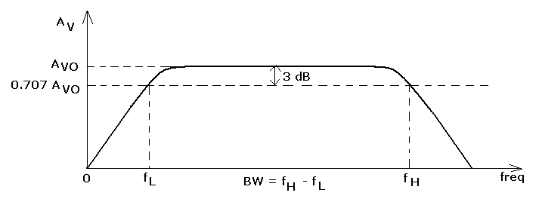
Frequency Response of RC coupled amplifier
Plot of Gain v/s input frequency
Gain is low at lower and higher frequencies
Gain is constant in the mid-band frequencies
Bandwidth of amplifier : f_{H} - f_{L}

Slide 11

At low frequencies, reactance of $C_{C}$ is very high. So, a part of input does not enter BJT. As a result gain reduces
Reactance of $C_{E}$ is also high. AC components of emitter current is not fully bypassed. Hence voltage drops across $R_{E}$ and the gain reduces.

Slide 12
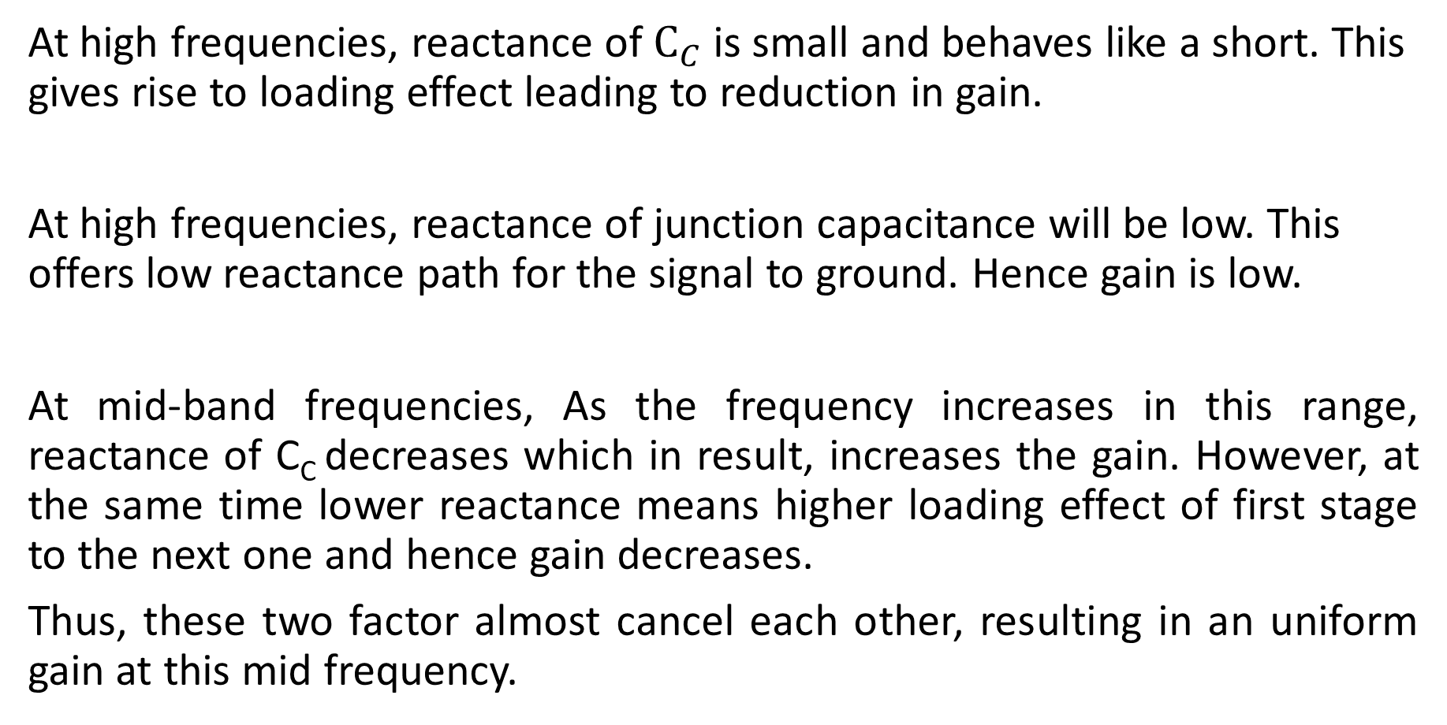
At high frequencies, reactance of $C_{C}$ is small and behaves like a short. This gives rise to loading effect leading to reduction in gain.
At high frequencies, reactance of junction capacitance will be low. This offers low reactance path for the signal to ground. Hence gain is low.
At mid-band frequencies, As the frequency increases in this range, reactance of C_{C} decreases which in result, increases the gain. However, at the same time lower reactance means higher loading effect of first stage to the next one and hence gain decreases.
Thus, these two factor almost cancel each other, resulting in an uniform gain at this mid frequency.

Slide 13

$C_{E}$ is designed such that reactance of capacitance must be < $\frac{1}{10}$ of $R_{E}$
Function of $C_{E}$ is to bypass emitter resistance during AC operation.
Otherwise, during amplification, with variation in current, voltage drop across $R_{E}$ will also vary.

Slide 14
$C_{E}$ is designed such that reactance of capacitance must be < $\frac{1}{10}$ of $R_{E}$
Function of $C_{E}$ is to bypass emitter resistance during AC operation.
Otherwise, during amplification, with variation in current, voltage drop across $R_{E}$ will also vary.

Slide 15
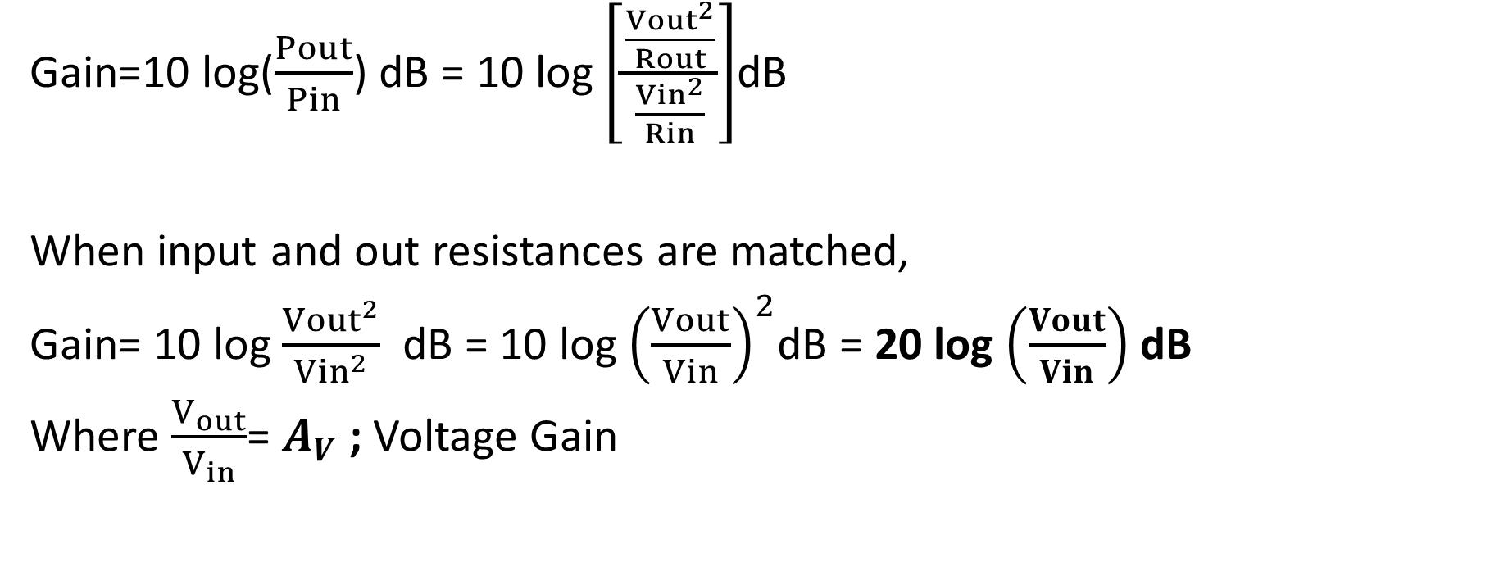
Gain of the amplifier
Gain=10 log($\frac{Pout}{Pin}$) dB = 10 log$\left[\frac{\frac{{Vout}^{2}}{Rout}}{\frac{{Vin}^{2}}{Rin}}\right]$dB
When input and out resistances are matched,
Gain= 10 log $\frac{{Vout}^{2}}{{Vin}^{2}}$ dB = 10 log ${\left(\frac{Vout}{Vin}\right)}^{2}$dB = 20 log $\left(\frac{Vout}{Vin}\right)$ dB
Where $\frac{V_{out}}{V_{in}}$= $A_{V}$ ; Voltage Gain

Slide 16

At cut off frequencies, power is HALF that of mid-band frequency.
Output voltage at cutoff frequencies= $\frac{V_{out}}{\sqrt{2}}$
⸫ Cut off Gain = 10 log ${\left[\frac{V_{out}}{{\sqrt{2 }V}_{in}}\right]}^{2}$
= 20 log (0.707 $∗A_{V}$)

Slide 20
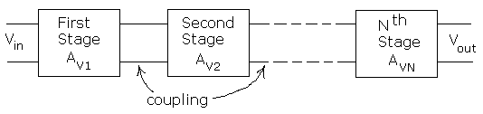

Multistage Amplifiers
Gain in decibels,
(A_{V})_{dB} = 20 log₁₀ | A_{V} |
Overall gain: $A_{V}=A_{V1}$* $A_{V2}$* $A_{V3}$*……..*$A_{VN}$
:${\left(A_{V}\right)}_{dB}$=${\left(A_{V1}\right)}_{dB}$+${\left(A_{V2}\right)}_{dB}$+${\left(A_{V3}\right)}_{dB}$+……+${\left(A_{VN}\right)}_{dB}$

Slide 21
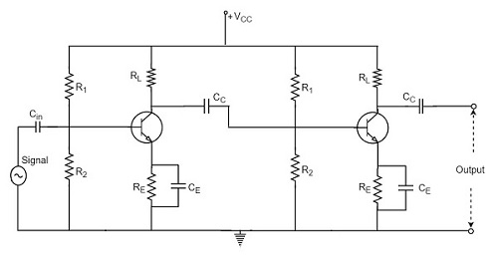
2 Stage RC Coupled Amplifier

Slide 22
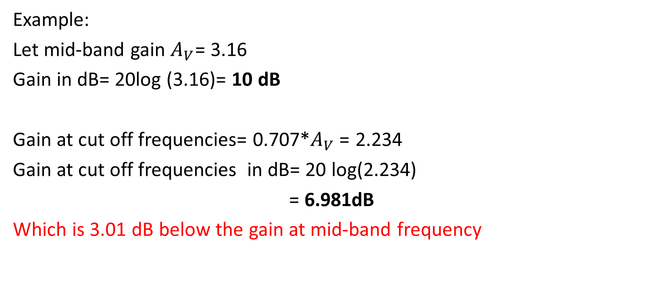
Example:
Let mid-band gain $A_{V}$= 3.16
Gain in dB= 20log (3.16)= 10 dB
Gain at cut off frequencies= 0.707*$A_{V}$= 2.234
Gain at cut off frequencies in dB= 20 log(2.234)
= 6.981dB
Which is 3.01 dB below the gain at mid-band frequency

Slide 23
Q1.An amplifier is known to have a power gain of 40dB. If the output power is 4W, determine the input power.

Slide 24
Q2.What output power is obtained from an amplifier whose power gain is 55 dB, when the input power is 1 mW?

Slide 25
Q3. In a three-stage amplifier, the voltage gain of first stage is 40 dB, gain of second stage is 200 and that of third stage is 0 dB. Find the overall gain of the amplifier.

Slide 26
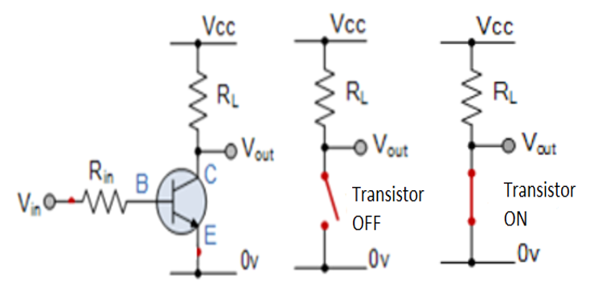
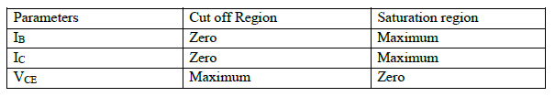
Transistor as a switch

Slide 27
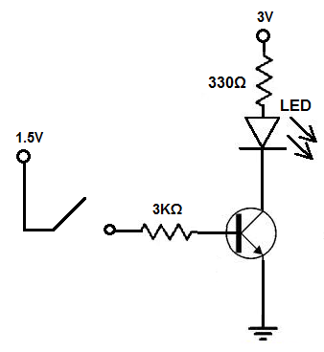
Transistor as a LED driver

Slide 28
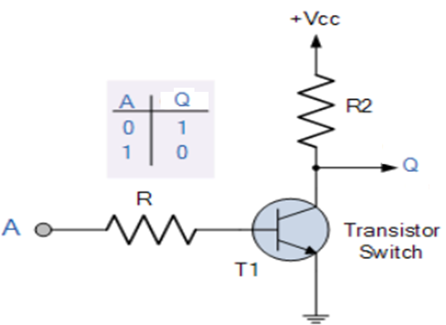
Transistor as an Inverter

